Slide 1

Data Analytics Lifecycle
GOA COLLEGE OF ENGINEERING
Affiliated to Goa University
INFORMATION TECHNOLOGY DEPARTMENT
Vision
Impart high quality knowledge and skills to students in the field of Information Technology ,motivate research, encourage industry consultancy projects and nurture human values and life skills.
Prepared By,
Ms. Diana Miranda
Assistant Professor
Dept. of Information Technology
Goa College of Engineering

Slide 2
Topics to be Covered
Data Analytics Lifecycle Overview
Phase 1: Discovery
Phase 2: Data Preparation
Phase 3: Model Planning
Phase 4: Model Building
Phase 5: Communicate Results
Phase 6: Operationalize
Case Study: Global Innovation Network and Analysis (GINA)

Slide 3
Data Analytics Lifecycle Overview

Slide 4
Key Roles for a Successful Analytics Project
Business User:
Someone who understands the domain area and usually benefits from the results.
Consult and advise the project team on the context of the project, the value of the results, and how the outputs will be operationalized.
Usually a business analyst, line manager, or deep subject matter expert in the project domain fulfills this role.
Project Sponsor:
Responsible for the genesis of the project.
Provides the impetus and requirements for the project and defines the core business problem.
Generally provides the funding and gauges the degree of value from the final outputs of the working team.
Sets the priorities for the project and clarifies the desired outputs.
Project Manager:
Ensures that key milestones and objectives are met on time and at the expected quality.
Business Intelligence Analyst:
Provides business domain expertise based on a deep understanding of the data, key performance indicators (KPis), key metrics, and business intelligence from a reporting perspective.
Create dashboards and reports and have knowledge of the data feeds and sources.
Database Administrator (DBA):
Provisions and configures the database environment to support the analytics needs of the working team. These responsibilities may include providing access to key databases or tables and ensuring the appropriate security levels are in place related to the data repositories.
Data Engineer:
Leverages deep technical skills to assist with tuning SQL queries for data management and data extraction, and provides support for data ingestion into the analytic sandbox
Whereas the DBA sets up and configures the databases to be used, the data engineer executes the actual data extractions and performs substantial data manipulation to facilitate the analytics.
The data engineer works closely with the data scientist to help shape data in the right ways for analyses.
Data Scientist:
Provides subject matter expertise for analytical techniques, data modeling, and applying valid analytical techniques to given business problems.
Ensures overall analytics objectives are met.
Designs and executes analytical methods and approaches with the data available to the project.

Slide 5
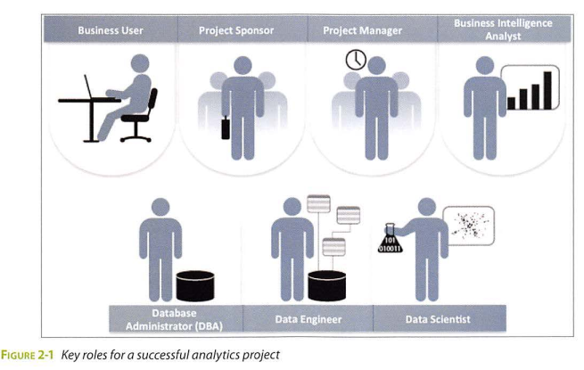

Slide 6
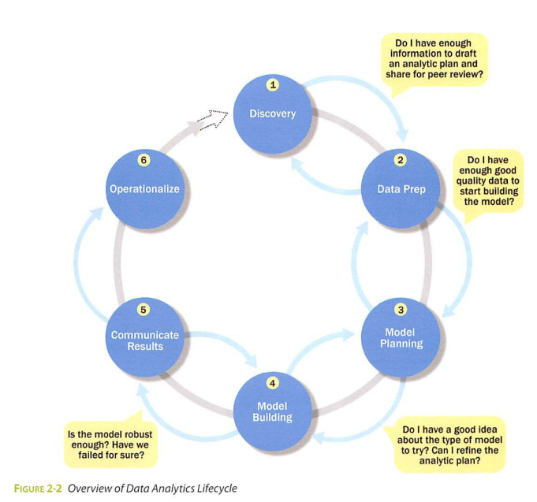
Big Data Overview
The Data Analytics Lifecycle defines analytics process best practices spanning discovery to project completion.
The lifecycle draws from established methods in the realm of data analytics and decision science.
This synthesis was developed after gathering input from data scientists and consulting established approaches that provided input on pieces of the process.

Slide 7
Several of the processes that were consulted include these:
Scientific method, in use for centuries, still provides a solid framework for thinking about and deconstructing problems into their principal parts. One of the most valuable ideas of the scientific method relates to forming hypotheses and finding ways to test ideas.
CRISP-OM provides useful input on ways to frame analytics problems and is a popular approach for data mining.
Tom Davenport's DELTA framework: The DELTA framework offers an approach for data analytics projects, including the context of the organization's skills, datasets, and leadership engagement.
Doug Hubbard's Applied Information Economics (AlE) approach: AlE provides a framework for measuring intangibles and provides guidance on developing decision models, calibrating expert estimates, and deriving the expected value of information.
"MAD Skills" by Cohen et al. offers input for several of the techniques mentioned in Phases 2-4 that focus on model planning, execution, and key findings.

Slide 8
Phase 1- Discovery:
the team learns the business domain, including relevant history such as whether the organization or business unit has attempted similar projects in the past from which they can learn.
The team assesses the resources available to support the project in terms of people, technology, time, and data.
Important activities in this phase include framing the business problem as an analytics challenge that can be addressed in subsequent phases and formulating initial hypotheses (IHs) to test and begin learning the data.
Phase 2- Data preparation:
Requires the presence of an analytic sandbox, in which the team can work with data and perform analytics for the duration of the project.
The team needs to execute extract, load, and transform (ELT) or extract, transform and load (ETL) to get data into the sandbox.
The ELT and ETL are sometimes abbreviated as ETLT.
Data should be transformed in the ETLT process so the team can work with it and analyze it.
In this phase, the team also needs to familiarize itself with the data thoroughly and take steps to condition the data
Phase 3-Model planning:
Team determines the methods, techniques, and workflow it intends to follow for the subsequent model building phase.
The team explores the data to learn about the relationships between variables and subsequently selects key variables and the most suitable models.

Slide 9
Phase 4-Model building:
Team develops datasets for testing, training, and production purposes.
In addition, in this phase the team builds and executes models based on the work done in the model planning phase.
The team also considers whether its existing tools will suffice for running the models, or if it will need a more robust environment for executing models and workflows (for example, fast hardware and parallel processing, if applicable).
Phase 5-Communicate results:
The team, in collaboration with major stakeholders, determines if the results of the project are a success or a failure based on the criteria developed in Phase 1.
The team should identify key findings, quantify the business value, and develop a narrative to summarize and convey findings to stakeholders.
Phase 6-0perationalize:
In Phase 6, the team delivers final reports, briefings, code, and technical documents.
The team may run a pilot project to implement the models in a production environment.

Slide 10
Once team members have run models and produced findings, it is critical to frame these results in a way that is tailored to the audience that engaged the team.
Moreover, it is critical to frame the results of the work in a manner that demonstrates clear value.
If the team performs a technically accurate analysis but fails to translate the results into a language that resonates with the audience, people will not see the value, and much of the time and effort on the project will have been wasted

Slide 11
Phase 1: Discovery

Slide 12
Topics
Learning the Business Domain
Resources
Framing the Problem
Identifying Key Stakeholders
Interviewing the Analytics Sponsor
Developing Initial Hypotheses
Identifying Potential Data Sources

Slide 13
In this phase, the data science team must
learn and investigate the problem,
develop context and understanding,
learn about the data sources needed and available for the project
In addition, the team formulates initial hypotheses that can later be tested with data.

Slide 14
Learning the Business Domain
Data scientists will have deep computational and quantitative knowledge that can be broadly applied across many disciplines.
At this early stage in the process, the team needs to determine how much business or domain knowledge the data scientist needs to develop models in Phases 3and 4.
Resources
The team needs to assess the resources available to support the project.
Resources include technology, tools, systems, data, and people.
The available tools and technology the team will be using and the types of systems needed for later phases to operationalize the models
In addition, try to evaluate the level of analytical sophistication within the organization and gaps that may exist related to tools, technology, and skills.
Take inventory of the types of data available to the team for the project.
An alternative approach is to consider the long-term goals of this kind of project, without being constrained by the current data.

Slide 15
Framing the Problem
Framing is the process of stating the analytics problem to be solved.
The team needs to clearly articulate the current situation and its main challenges.
As part of this activity, it is important to identify the main objectives of the project, identify what needs to be achieved in business terms, and identify what needs to be done to meet the needs.
Additionally, consider the objectives and the success criteria for the project.
Equally important is to establish failure criteria: The failure criteria will guide the team in understanding when it is best to stop trying or settle for the results that have been gleaned from the data.
Identifying Key Stakeholders
The team can identify the success criteria, key risks, and stakeholders, which should include anyone who will benefit from the project or will be significantly impacted by the project.
When interviewing stakeholders, learn about the domain area and any relevant history from similar analytics projects.
Depending on the number of stakeholders and participants, the team may consider outlining the type of activity and participation expected from each stakeholder and participant.

Slide 16
Interviewing the Analytics Sponsor
At the outset, project sponsors may have a predetermined solution that may not necessarily realize the desired outcome.
In these cases, the team must use its knowledge and expertise to identify the true underlying problem and appropriate solution
The data science team can take a more objective approach, as the stakeholders may have developed biases over time, based on their experience.
Also, what may have been true in the past may no longer be a valid working assumption.
One possible solution is for the project sponsor to focus on clearly defining the requirements, while the other members of the data science team focus on the methods needed to achieve the goals.

Slide 17
Developing Initial Hypotheses
Involves forming ideas that the team can test with data.
It is best to come up with a few primary hypotheses to test and then be creative about developing several more.
These IHs form the basis of the analytical tests the team will use in later phases and serve as the foundation for the findings in Phase 5.
Another part of this process involves gathering and assessing hypotheses from stakeholders and domain experts who may have their own perspective on what the problem is, what the solution should be, and how to arrive at a solution.

Slide 18
Identifying Potential Data Sources
Identify the kinds of data the team will need to solve the problem.
Consider the volume, type, and time span of the data needed to test the hypotheses.
Ensure that the team can access more than simply aggregated data.
The team should perform five main activities during this step ofthe discovery phase:
Identify data sources
Capture aggregate data sources
Review the raw data
Evaluate the data structures and tools needed
Scope the sort of data infrastructure needed for this type of problem

Slide 19
Phase 2: Data Preparation

Slide 20
The second phase of the Data Analytics Lifecycle involves data preparation, which includes the steps to explore, preprocess, and condition data prior to modeling and analysis.
In this phase, the team needs to create a robust environment in which it can explore the data that is separate from a production environment.
Usually, this is done by preparing an analytics sandbox.
The team needs to execute extract, load, and transform (ELT) or extract, transform and load (ETL) to get data into the sandbox.
The ELT and ETL are sometimes abbreviated as ETLT. Data should be transformed in the ETLT process so the team can work with it and analyze it.
Consider an example in which the team needs to work with a company's financial data.
The team should access a copy of the financial data from the analytic sandbox rather than interacting with the production version of the organization's main database, because that will be tightly controlled and needed for financial reporting.

Slide 21
Rules for Analytics Sandbox
When developing the analytic sandbox, it is a best practice to collect all kinds of data there, as team members need access to high volumes and varieties of data for a Big Data analytics project.
This can include everything from summary-level aggregated data, structured data , raw data feeds, and unstructured text data from call logs or web logs, depending on the kind of analysis the team plans to undertake.
A good rule is to plan for the sandbox to be at least 5– 10 times the size of the original datasets, partly because copies of the data may be created that serve as specific tables or data stores for specific kinds of analysis in the project.

Slide 22
Performing ETLT
Before data transformations, make sure the analytics sandbox has ample bandwidth and reliable network connections to the underlying data sources to enable uninterrupted read and write.
In ETL, users perform extract, transform, load processes to extract data from a data store, perform data transformations, and load the data back into the data store.
However, the analytic sandbox approach differs slightly; it advocates extract, load, and then transform.
In this case, the data is extracted in its raw form and loaded into the data store, where analysts can choose to transform the data into a new state or leave it in its original, raw condition.
The reason for this approach is that there is significant value in preserving the raw data and including it in the sandbox before any transformations take place.

Slide 23
Performing ETLT
As part of the ETLT step, it is advisable to make an inventory of the data and compare the data currently available with datasets the team needs.
Performing this sort of gap analysis provides a framework for understanding which datasets the team can take advantage of today and where the team needs to initiate projects for data collection or access to new datasets currently unavailable.
A component of this sub-phase involves extracting data from the available sources and determining data connections for raw data, online transaction processing (OLTP) databases, online analytical processing (OLAP) cubes, or other data feeds.

Slide 24
Learning About the Data
Spending time to learn the nuances of the datasets provides context to understand what constitutes a reasonable value and expected output versus what is a surprising finding.
Important to catalog the data sources that the team has access to and identify additional data sources that the team can leverage but perhaps does not have access to today.
Doing this activity accomplishes several goals.
Clarifies the data that the data science team has access to at the start of the project
Highlights gaps by identifying datasets within an organization that the team may find useful but may not be accessible to the team today.
Identifies datasets outside the organization that may be useful to obtain, through open APIs, data sharing, or purchasing data to supplement already existing datasets

Slide 25
Data Conditioning
Data conditioning refers to the process of cleaning data, normalizing datasets, and performing transformations on the data.
A critical step within the Data Analytics Lifecycle, data conditioning can involve many complex steps to join or merge datasets or otherwise get datasets into a state that enables analysis in further phases.
Data conditioning is often viewed as a preprocessing step for the data analysis because it involves many operations on the dataset before developing models to process or analyze the data.
Additional questions and considerations for the data conditioning step include these.
What are the data sources? What are the target fields (for example, columns of the tables)?
How clean is the data?
How consistent are the contents and files?
Assess the consistency of the data types.
Review the content of data columns or other inputs, and check to ensure they make sense.
Look for any evidence of systematic error.

Slide 26
Survey and Visualize
Seeing high-level patterns in the data enables one to understand characteristics about the data very quickly
Shneiderman is well known for his mantra for visual data analysis of "overview first, zoom and filter, then details-on-demand." This is a pragmatic approach to visual data analysis. It enables the user to find areas of interest, zoom and filter to find more detailed information about a particular area of the data, and then find the detailed data behind a particular area
When pursuing this approach with a data visualization tool or statistical package, the following guidelines and considerations are recommended.
Review data to ensure that calculations remained consistent within columns or across tables for a given data field.
Does the data distribution stay consistent over all the data? If not, what kinds of actions should be taken to address this problem?
Assess the granularity of the data, the range of values, and the level of aggregation of the data.
Does the data represent the population of interest?
For time-related variables, are the measurements daily, weekly, monthly?
Is the data standardized/ normalized? Are the scales consistent? If not, how consistent or irregular is the data?
For geospatial datasets, are state or country abbreviations consistent across the data?
Becoming deeply knowledgeable about the data will be critical when it comes time to construct and run models later in the process.

Slide 27
Common Tools for the Data Preparation Phase
Several tools are commonly used for this phase:
Hadoop can perform massively parallel ingest and custom analysis for web traffic analysis, GPS location analytics, and combining of massive unstructured data feeds from multiple sources.
Alpine Miner provides a graphical user interface (GUI) for creating analytic workflows, including data manipulations and a series of analytic events such as staged data-mining techniques (for example, first select the top 100 customers, and then run descriptive statistics and clustering).
OpenRefine (formerly called Google Refine) is “a free, open source, powerful tool for working with messy data. A GUI-based tool for performing data transformations, and it's one of the most robust free tools currently available.
Similar to OpenRefine, Data Wrangler is an interactive tool for data cleaning and transformation. Wrangler was developed at Stanford University and can be used to perform many transformations on a given dataset.

Slide 28
Phase 3: Model Planning

Slide 29
Phase 3 is model planning, where the team determines the methods, techniques, and workflow it intends to follow for the subsequent model building phase.
The team explores the data to learn about the relationships between variables and subsequently selects key variables and the most suitable models.
Some of the activities to consider in this phase include the following:
Assess the structure of the datasets. The structure of the datasets is one factor that dictates the tools and analytical techniques for the next phase. Depending on whether the team plans to analyze textual data or transactional data, for example, different tools and approaches are required.
Ensure that the analytical techniques enable the team to meet the business objectives and accept or reject the working hypotheses.
Determine if the situation warrants a single model or a series of techniques as part of a larger analytic workflow.
In addition to the considerations just listed, it is useful to research and understand how other analysts generally approach a specific kind of problem.

Slide 30
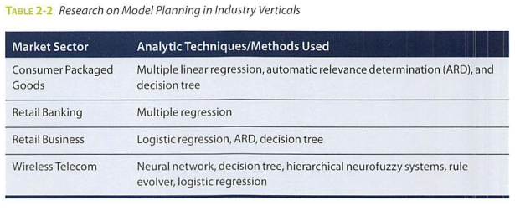

Slide 31
Data Exploration and Variable Selection
Although some data exploration takes place in the data preparation phase, those activities focus mainly on data hygiene and on assessing the quality of the data itself.
In Phase 3, the objective of the data exploration is to understand the relationships among the variables to inform selection of the variables and methods and to understand the problem domain
A common way to conduct this step involves using tools to perform data visualizations.
Approaching the data exploration in this way aids the team in previewing the data and assessing relationships between variables at a high level aim for capturing the most essential predictors and variables rather than considering every possible variable that people think may influence the outcome.

Slide 32
Model Selection
The team's main goal is to choose an analytical technique, or a short list of candidate techniques, based on the end goal of the project.
When reviewing this list of types of potential models, the team can winnow down the list to several viable models to try to address a given problem.
An additional consideration in this area for dealing with Big Data involves determining if the team will be using techniques that are best suited for structured data, unstructured data, or a hybrid approach.
Lastly, the team should take care to identify and document the modeling assumptions it is making as it chooses and constructs preliminary models.
Typically, teams create the initial models using a statistical software package such as R, SAS, or Matlab.
Although these tools are designed for data mining and machine learning algorithms, they may have limitations when applying the models to very large datasets, as is common with Big Data.
As such, the team may consider redesigning these algorithms to run in the database itself during the pilot phase mentioned in Phase 6.
The team can move to the model building phase once it has a good idea about the type of model to try and the team has gained enough knowledge to refine the analytics plan.
Advancing from this phase requires a general methodology for the analytical model, a solid understanding of the variables and techniques to use, and a description or diagram of the analytic workflow.

Slide 33
Common Tools for the Model Planning Phase
Here are several of the more common ones:
R has a complete set of modeling capabilities and provides a good environment for building interpretive models with high-quality code. In addition, it has the ability to interface with databases via an ODBC connection and execute statistical tests.
SQL Analysis services can perform in-database analytics of common data mining functions, involved aggregations, and basic predictive models.
SAS/ ACCESS provides integration between SAS and the analytics sandbox via multiple data connectors such as OBDC, JDBC, and OLE DB. SAS itself is generally used on file extracts, but with SAS/ ACCESS, users can connect to relational databases (such as Oracle or Teradata).

Slide 34
Phase 4: Model Building

Slide 35
The data science team needs to develop datasets for training, testing, and production purposes.
These datasets enable the data scientist to develop the analytical model and train it while holding aside some of the data for testing the model.
During this process, it is critical to ensure that the training and test datasets are sufficiently robust for the model and analytical techniques. A simple way to think of these datasets is to view the training dataset for conducting the initial experiments and the test sets for validating an approach once the initial experiments and models have been run.
In the model building phase, an analytical model is developed and fit on the training data and evaluated (scored) against the test data.
The phases of model planning and model building can overlap quite a bit, and in practice one can iterate back and forth between the two phases for awhile before settling on a final model.
Although the modeling techniques and logic required to develop models can be highly complex, the actual duration of this phase can be short compared to the time spent preparing the data and defining the approaches.
In general, plan to spend more time preparing and learning the data(Phases 1-2) and crafting a presentation of the findings (Phase 5). Phases 3 and 4 tend to move more quickly, although they are more complex from a conceptual standpoint.
As part of this phase, the data science team needs to execute the models defined in Phase 3.
When immersed in the details of constructing models and transforming data, many small decisions are often made about the data and the approach for the modeling. These details can be easily forgotten once the project is completed. Therefore, it is vital to record the results and logic of the model during this phase. In addition, one must take care to record any operating assumptions that were made in the modeling process regarding the data or the context.

Slide 36
Common Tools for the Model Building Phase
Common tools in this space include, but are not limited to, the following:
Commercial Tools: SAS Enterprise Miner, SPSSModeler, Matlab, Alpine Miner, STATISTICA and Mathematica
Free or Open Source tools: Rand PL/R, Octave, WEKA, Python, SQL in-database implementations, such as MADlib

Slide 37
Phase 5: Communicate Results

Slide 38
After executing the model, the team needs to compare the outcomes of the modeling to the criteria established for success and failure.
In Phase 5, the team considers how best to articulate the findings and outcomes to the various team members and stakeholders, taking into account caveats, assumptions, and any limitations of the results.
The team needs to determine if it succeeded or failed in its objectives. Many times people do not want to admit to failing, but in this instance failure should not be considered as a true failure, but rather as a failure of the data to accept or reject a given hypothesis adequately.
When conducting this assessment, determine if the results are statistically significant and valid. If they are, identify the aspects of the results that stand out and may provide salient findings when it comes time to communicate them. If the results are not valid, think about adjustments that can be made to refine and iterate on the model to make it valid.
The best practice in this phase is to record all the findings and then select the three most significant ones that can be shared with the stakeholders.
In addition, the team needs to reflect on the implications of these findings and measure the business value.
Depending on what emerged as a result of the model, the team may need to spend time quantifying the business impact of the results to help prepare for the presentation and demonstrate the value of the findings.
Now that the team has run the model, completed a thorough discovery phase, and learned a great deal about the datasets, reflect on the project and consider what obstacles were in the project and what can be improved in the future. Make recommendations for future work or improvements to existing processes, and consider what each of the team members and stakeholders needs to fulfill her responsibilities.
The deliverable of this phase will be the most visible portion of the process to the outside stakeholders and sponsors, so take care to clearly articulate the results, methodology, and business value of the findings.

Slide 39
Phase 6: Operationalize

Slide 40
In the final phase, the team communicates the benefits of the project more broadly and sets up a pilot project to deploy the work in a controlled way before broadening the work to a full enterprise or ecosystem of users.
Phase 6, represents the first time that most analytics teams approach deploying the new analytical methods or models in a production environment. Rather than deploying these models immediately on a wide-scale basis, the risk can be managed more effectively and the team can learn by undertaking a small scope, pilot deployment before a wide-scale rollout. This approach enables the team to learn about the performance and related constraints of the model in a production environment on a small scale and make adjustments before a full deployment.
During the pilot project, the team may need to consider executing the algorithm in the database rather than with in-memory tools such as R because the run time is significantly faster and more efficient than running in-memory, especially on larger datasets.
A new set of team members form a technical group needs to ensure that running the model fits smoothly into the production environment and that the model can be integrated into related business processes.
Part of the operationalizing phase includes creating a mechanism for performing ongoing monitoring of model accuracy and, if accuracy degrades, finding ways to retrain the model.
The key outputs for each of the main stakeholders of an analytics project and what they usually expect at the conclusion of a project are:
Business User typically tries to determine the benefits and implications of the findings to the business.
Project Sponsor typically asks questions related to the business impact of the project, the risks and return on investment (ROI), and the way the project can be evangelized within the organization (and beyond).
Project Manager needs to determine if the project was completed on time and within budget and how well the goals were met.
Business Intelligence Analyst needs to know if the reports and dashboards he manages will be impacted and need to change.
Data Engineer and Database Administrator (DBA) typically need to share their code from the analytics project and create a technical document on how to implement it.
Data Scientist needs to share the code and explain the model to her peers, managers, and other stakeholders.
Although these seven roles represent many interests within a project, these interests usually overlap, and most of them can be met with 4 main deliverables.
Presentation for project sponsors: This contains high-level takeaways for executive level stakeholders, with a few key messages to aid their decision-making process. Focus on clean, easy visuals for the presenter to explain and for the viewer to grasp.
Presentation for analysts, which describes business process changes and reporting changes. Fellow data scientists will want the details and are comfortable with technical graphs (such as Receiver Operating Characteristic [ROC) curves, density plots, and histograms).
Code for technical people.
Technical specifications of implementing the code.

Slide 41
Case Study: Global Innovation Network and Analysis (GINA)

